Slide 1
Classical Greece
Chapter 5 - World History
Mr. Holzhauser

Slide 2
Cultures of the Mountains and the Sea
Section 1

Slide 3
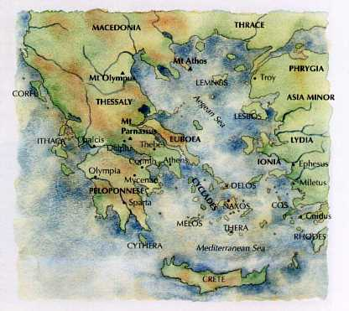
Cultures of the Mountains and Sea
Greece consists of 2,000 islands in Aegean Sea and Ionian Sea
Covered in mountains
People became sailors and traders
Few natural resources

Slide 4
Mycenaean Civilization
Indo-Europeans who settled Greece 2000 B.C.
Strong Military/Kings
Contact with Minoans – 1500 B.C.
Adopted religion, art, politics, and literature
May have adopted writing system

Slide 5
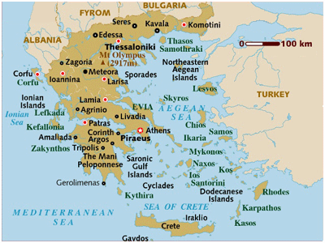

Slide 6
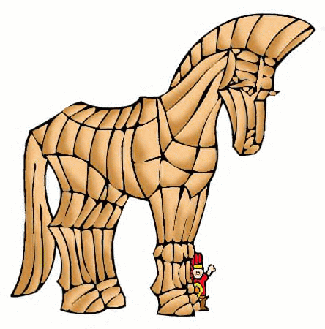
Trojan War
10 year war between Mycenaeans and Trojans
Started by the theft of Queen Helen of Sparta by Prince Paris of Troy
Basis for Homer’s Iliad and Odyssey

Slide 8
The Dorians
Dorians seize power after Trojan War
Ethnic group from island of Crete
Not very advanced; did not have writing system, so very little is known
Stories passed by spoken word
Homer begins epic poems – Iliad and Odyssey
Greeks myths begin to form
Perseus
Hercules

Slide 9
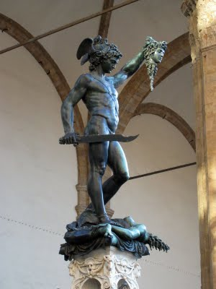
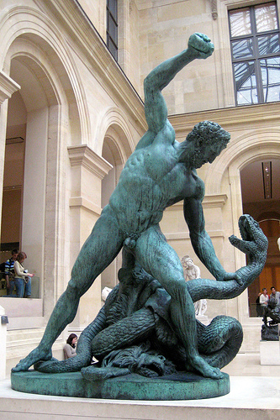
Perseus and Hercules

Slide 10
Warring City-States
Section 2

Slide 11
Warring City-States
Polis – city-state – becomes fundamental political unit in Greece
Acropolis – marketplace – becomes center of town, all business and government matters
Individual cities create separate ruling styles
Monarchy
Aristocracy
Oligarchy

Slide 13
Government
Monarchy – Rule by king, use mandate of heaven, Mycenae
Aristocracy – Rule by nobility, social status and wealth determine position, Athens <594 B.C.
Oligarchy – Rule by few citizens, determined by wealth or strength, Sparta around 500 B.C.
Many states ruled by tyrants – powerful leader dedicated to protecting city-state

Slide 14
Athens
Athens – focus on representative government
Draco – 621 B.C. – forms first legal code – punishment of death for all crimes
Solon – 594 B.C. – outlaws debt slavery, not all slavery
Cleistenes – Creates representative gov. based on where you live rather than nobility/wealth
Allows all citizens to submit laws
Creates Council of Five Hundred – proposes laws to assembly
Citizens are free, only property owning males

Slide 15
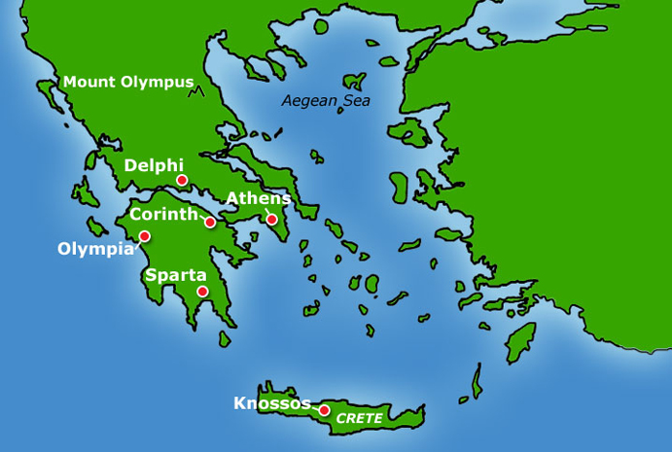
Athens
Athens
Education to wealthy males and females
Males learn the arts
Females learn home skills

Slide 16
Athens and Sparta
Sparta becomes a military state
Conquers neighboring Messinians 725 B.C.
Become Helots – peasants forced to work the land.
Revolt around 650 B.C. Resulting in narrow victory by Spartans
Spartans dedicate themselves to warfare

Slide 17
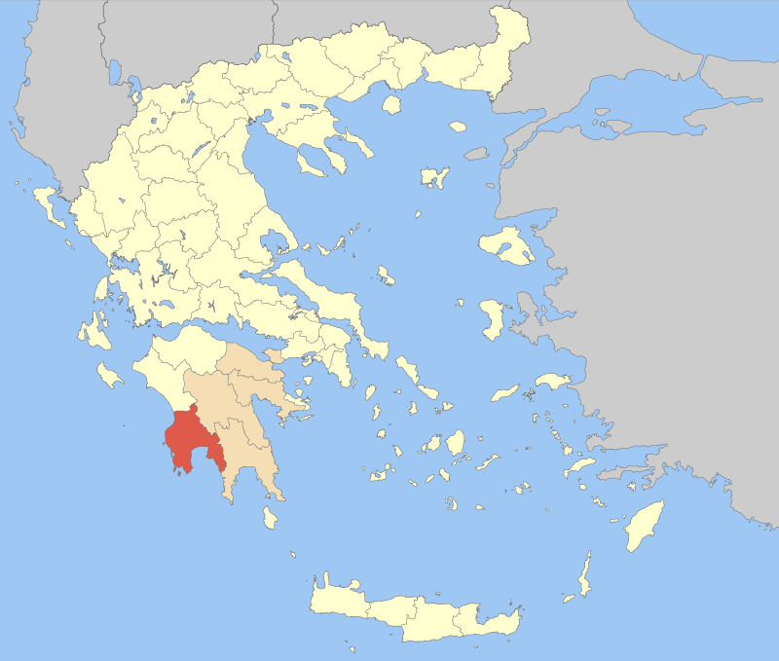

Slide 18
Sparta
Most powerful City-State due to their great army
Little value in arts, focus lay in organization and discipline
Boys left home at 7, stayed in military until 30
Girls also received military training , told to put state before themselves.
Women encouraged men “Come back with your shield or on it”
Surrender was not an option, better to die then to lose in battle

Slide 19
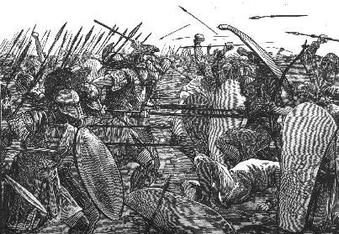
Hoplites in Action

Slide 20
Persian Wars
Darius led many attempts to conquer Greece, all failed. Famous battle of Marathon 490 B.C.
Pheidippides – ran from Marathon to Athens to proclaim Greek Nike (Victory), then died.
Xerxes leads great army against Greeks at Thermopylae – 480 B.C.
Athens wanted to surrender, Sparta wanted to fight
Spartan oligarchy allows only 300 Spartans under Leonidas to go, along with 7,000 other Greek soldiers

Slide 21
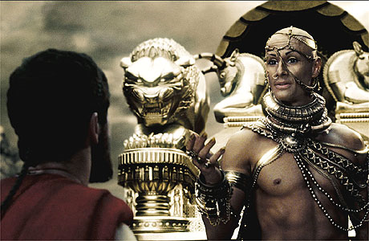
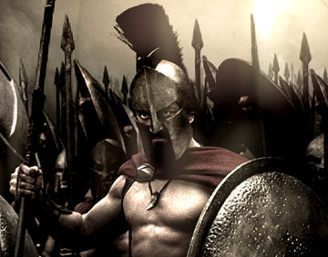
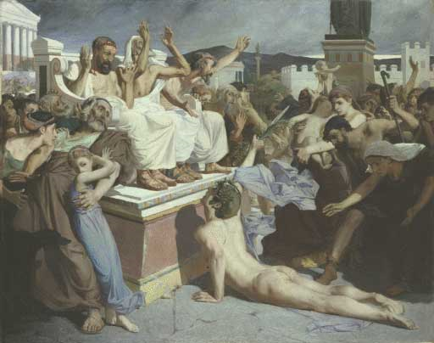

Slide 22
Democracy and Greece’s Golden Age
Section 3

Slide 23
Greece’s Golden Age
Pericles leads Athens – Focus on 3 Keys goals
Strengthen Athenian Democracy
Paid Government positions
All citizen involved in democracy – Direct Democracy
Strengthen Empire
Strong navy secures seas and trade throughout waterways
Glorify Athens
Beautified Athens with Gold, Ivory, and Marble

Slide 24
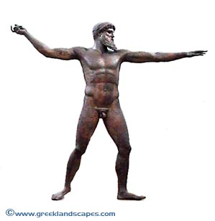
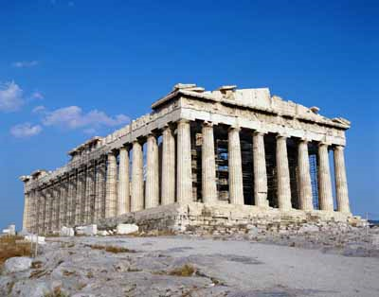
Glorious Art and Architecture
Parthenon – built to honor Athena
Classical art – focused on human beauty, harmony, order, balance

Slide 25
Drama and History
Theater – 2 kinds of Drama
Tragedy – Focused on love, hate, war, betrayal, hubris (Excessive pride)
Comedy – Slapstick situations, crude humor
History
Epic Poems recount stories
Historians recorded accurate reporting's of events
Herodotus – recorded history of Persian Wars
Thucydides – wrote about the study of history

Slide 26
Peloponnesian War
Athens grows wealthy and powerful, other city-states become hostile
Sparta declares war on Athens 431 B.C.
Sparta has strong army, Athens strong navy
Trade blows – Athens raids shore with navy, Sparta raids Athenian fields with army
Sparta eventually wins in 404 B.C. after Athens surrenders

Slide 27
Philosophers
Socrates – Believed in absolute standards for truth and justice
Condemned for “corrupting the youth of Athens” and sentenced to death
Plato – Student of Socrates noted for chronicling the teachings of Socrates and writing The Republic – his idea for a perfect society
Aristotle – Student of Plato and teacher to Alexander the Great

Slide 28
Philip II
Ruled Macedonia from 359-336 B.C. and transformed it into a powerful military machine
Moved into northern Greece and met little resistance due to residual effects of Peloponnesian War
By 338 he had Greece under his control

Slide 29
Macedonia

Slide 30
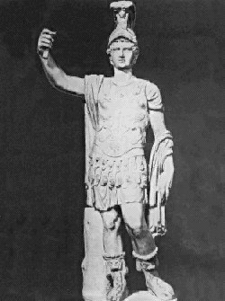
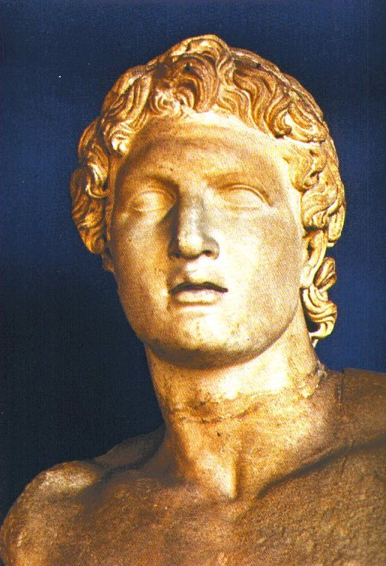
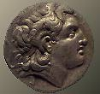
Alexander the Great 356-323 B.C.E.

Slide 31
Alexander Becomes King
Philip’s conquests might have continued, but he was assassinated
Title, plans for conquests fell to son, Alexander the Great
Alexander only 20, but had been trained to rule almost from birth
Learned warfare and politics from father, mother, and Aristotle
Alexander’s Conquests
Alexander faced almost immediately with revolts in Greece
Set out to reestablish control
Used harsh measures to show rebellion not tolerated
Crushed Theban army and sold people into slavery, burned city

Slide 32
Expanding the Empire
With defeat of Darius III, Alexander the master of Persian world
Troops marched to Persepolis, a Persian capital, burned it to ground as sign of victory
But Alexander not satisfied with size of empire
Led army deeper into Asia, winning more victories
Led army to the Indus, perhaps to conquer India
Soldiers had had enough, refused to proceed farther from home
Alexander forced to turn back to west

Slide 33
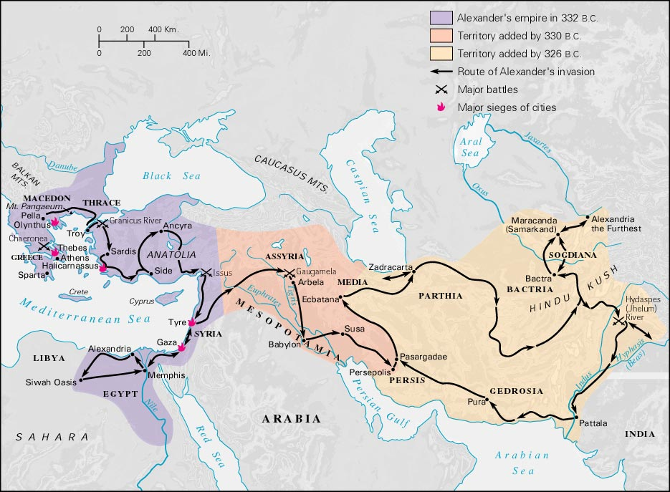
Alexander the Great’s Empire

Slide 34
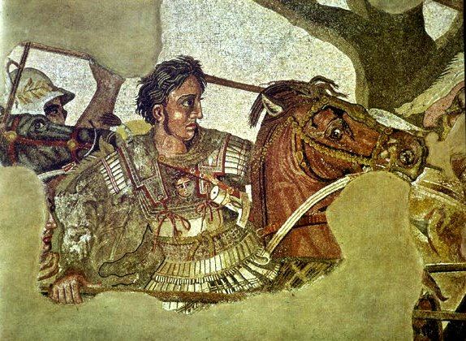
Alexander the Great in Persia

Slide 35
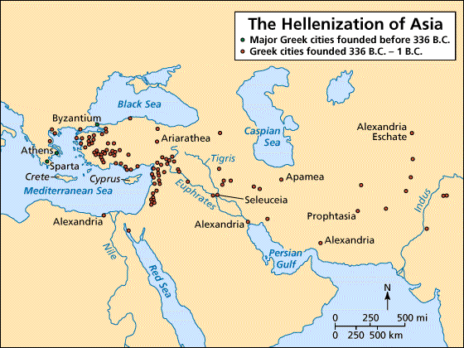
Building Greek Cities in the East

Slide 36
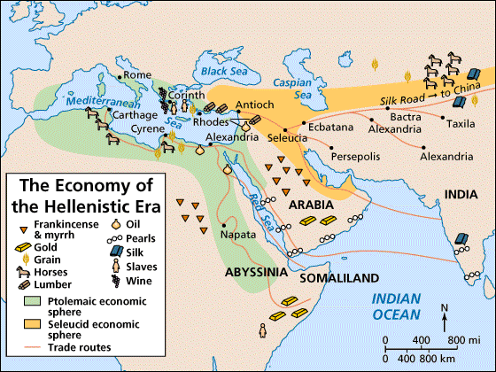
Trade in the Hellenistic World

Slide 37
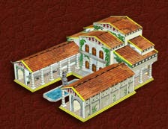
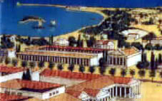
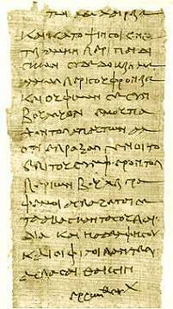
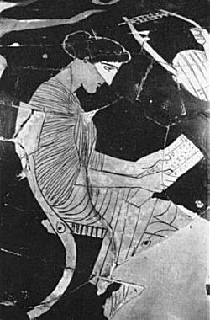
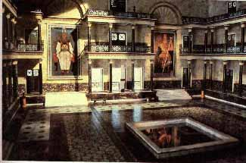
Library at Alexandria (333 B.C.E.)

Slide 38
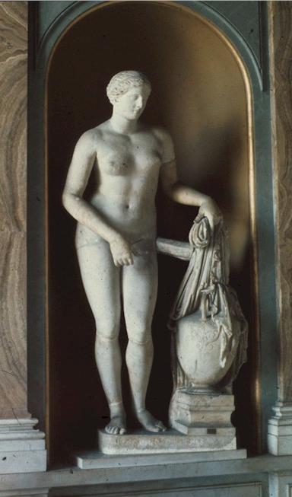
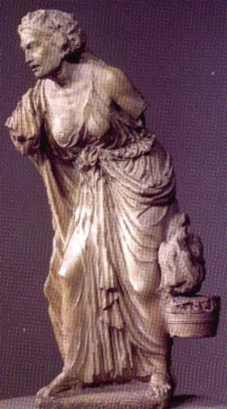
Hellenic vs. Hellenistic Art

Slide 39
Section 5 The Spread of Hellenistic Culture
Know Vocabulary
Hellenistic
Alexandria
Euclid
Archimedes
Colossus of Rhodes

