Slide 1
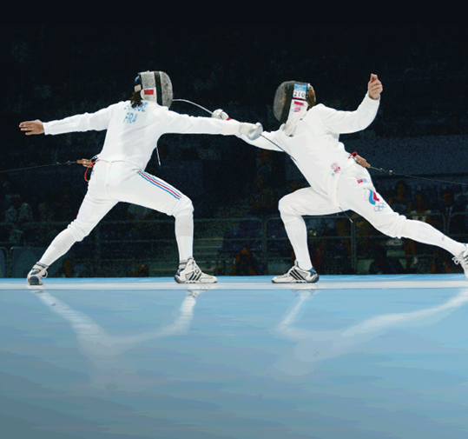
30–1 Human Body Systems
Mrs. Haywood
Notes:
Photo Credit: AP/Wide World Photos.

Slide 2
Organization of the Body
Organization of the Body
How is the human body organized?
The levels of organization in a multi-cellular organism include:
cells
tissues
organs
organ systems

Slide 3
Organization of the Body
Every cell in the human body is both an independent unit and an interdependent part of a larger community—the entire organism.
Cells
A cell is the basic unit of structure and function in living things.
Individual cells in multi-cellular organisms are specialized.
Specialized cells are suited to perform a particular function.

Slide 4
Organization of the Body
Tissues
A group of cells that perform a single function is called a tissue.
There are four basic types of tissue in the human body: epithelial, connective, nervous, and muscle.

Slide 5
Organization of the Body
Epithelial tissue includes glands and tissues that cover interior and exterior body surfaces.
Connective tissue supports the body and connects its parts.
Nervous tissue transmits nerve impulses through the body.
Muscle tissue, along with bones, enables the body to move.

Slide 6
Organization of the Body
Organs and Organ Systems
A group of different types of tissues that work together to perform a single function is called an organ.
A group of organs that perform closely related functions is an organ system.
There are eleven organ systems in the body.

Slide 7
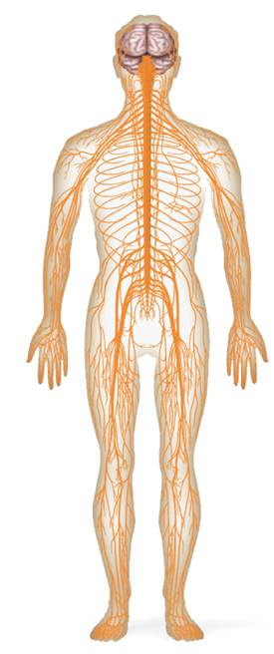
Organization of the Body
Nervous System
Structures: Brain, spinal cord, peripheral nerves
Function: Recognizes and coordinates the body’s response to changes in its internal and external environments

Slide 8
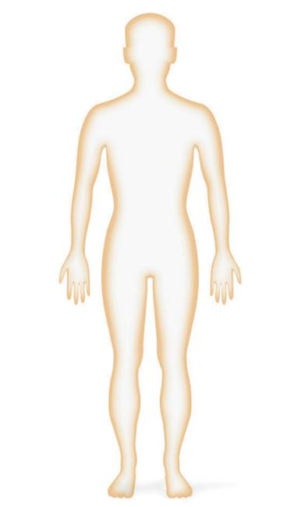
Organization of the Body
Integumentary System
Structures: Skin, hair, nails, sweat and oil glands
Function: Serves as a barrier against infection and injury; helps to regulate body temperature; provides protection against ultraviolet radiation from the sun

Slide 9
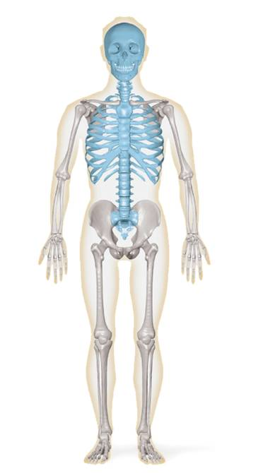
Organization of the Body
Skeletal System
Structures: Bones, cartilage, ligaments, tendons
Function: Supports the body; protects internal organs; allows movement; stores mineral reserves; provides a site for blood cell formation

Slide 10
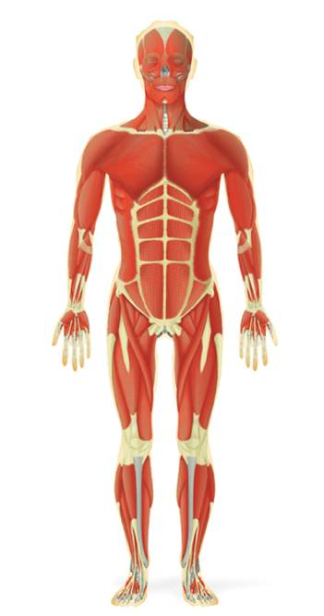
Organization of the Body
Muscular System
Structures: Skeletal muscle, smooth muscle, cardiac muscle
Function: Works with skeletal system to produce voluntary movement; helps to circulate blood and move food through the digestive system

Slide 11
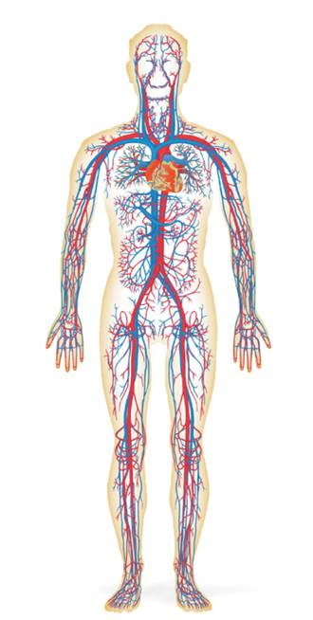
Organization of the Body
Circulatory System
Structures: Heart, blood vessels, blood
Function: Brings oxygen, nutrients, and hormones to cells; fights infection; removes cell wastes; helps to regulate body temperature

Slide 12
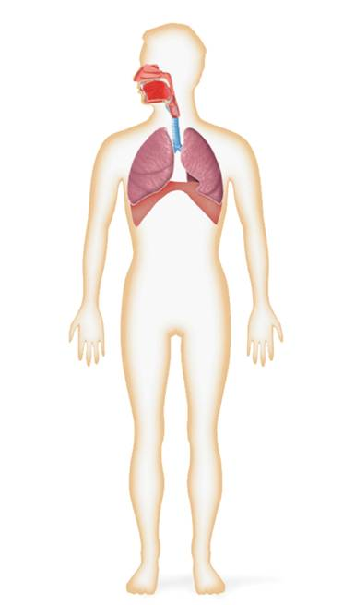
Organization of the Body
Respiratory System
Structures: Nose, pharynx, larynx, trachea, bronchi, bronchioles, lungs
Function: Provides oxygen needed for cellular respiration and removes excess carbon dioxide from the body

Slide 13
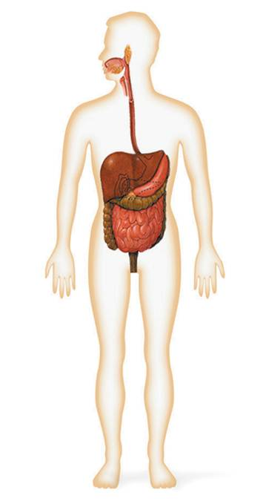
Organization of the Body
Digestive System
Structures: Mouth, pharynx, esophagus, stomach, small and large intestines, rectum
Function: Converts food into simpler molecules that can be used by the cells of the body; absorbs food; eliminates wastes

Slide 14
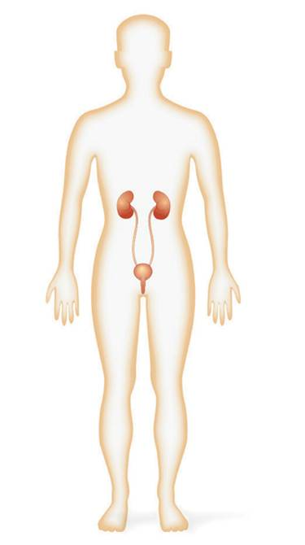
Organization of the Body
Excretory System
Structures: Skin, lungs, kidneys, ureters, urinary bladder, urethra
Function: Eliminates waste products from the body in ways that maintain homeostasis

Slide 15
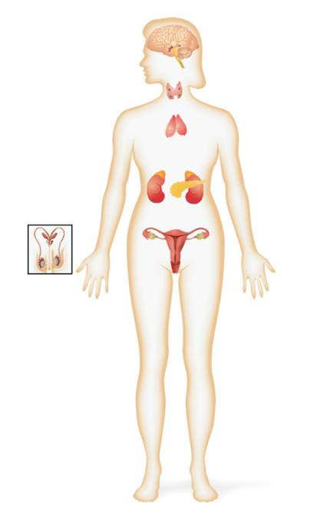
Organization of the Body
Endocrine System
Structures: Hypothalamus, pituitary, thyroid, parathyroid, adrenals, pancreas, ovaries (in females), testes (in males)
Function: Controls growth, development and metabolism; maintains homeostasis

Slide 16
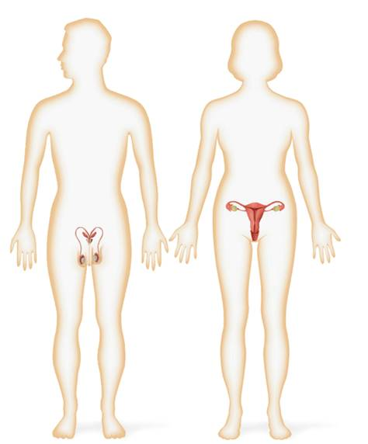
Organization of the Body
Reproductive System
Structures: Testes, epididymis, vas deferens, urethra, and penis (in males), ovaries, Fallopian tubes, uterus, vagina (in females)
Function: Produces reproductive cells; in females, nurtures and protects developing embryo

Slide 17
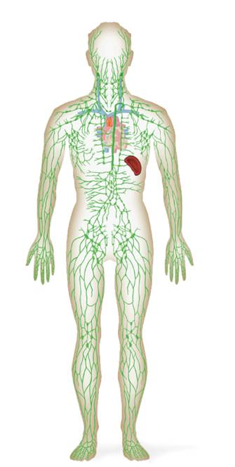
Organization of the Body
Lymphatic/Immune Systems
Structures: White blood cells, thymus, spleen, lymph nodes, lymph vessels
Function: Helps protect the body from disease; collects fluid lost from blood vessels and returns the fluid to the circulatory system

Slide 18
Maintaining Homeostasis
Maintaining Homeostasis
What is homeostasis?

Slide 19
Maintaining Homeostasis
Homeostasis is the process by which organisms keep internal conditions relatively constant despite changes in external environments.
Homeostasis in the body is maintained by feedback inhibition.

Slide 20
Maintaining Homeostasis
Feedback inhibition, or negative feedback, is the process in which a stimulus produces a response that opposes the original stimulus.
Systems controlled by feedback inhibition are fully automated and very stable.

Slide 21
Maintaining Homeostasis
Thermostat senses temperature change and switches off heating system
An Example of Feedback Inhibition
Room temperature increases
Room temperature decreases
Thermostat senses temperature change and switches on heating system
Notes:
Homeostasis is the process by which organisms keep internal conditions relatively constant despite changes in external environments. A home heating system uses a feedback mechanism to maintain a stable, comfortable environment within a house.

Slide 22
Maintaining Homeostasis
Homeostasis In the Body
Maintenance of homeostasis requires the integration of all organ systems at all times.
One example is the maintenance of a stable body temperature.

Slide 23
Maintaining Homeostasis
The hypothalamus monitors the temperature of the skin and the temperature of organs.
If core body temperature drops, the hypothalamus:
causes blood vessels in the skin to constrict reducing heat loss from skin.
causes the skeletal muscles to contract involuntarily—to “shiver.”
This causes the body temperature to increase.

Slide 24
Maintaining Homeostasis
If the core body temperature increases, the hypothalamus:
causes blood vessels in the skin to dilate so heat can escape from the skin.
the body produces sweat, which cools the body by evaporation.
This causes the body temperature to decrease.

